Slide 1

PYTHON
AND A PIECE OF PAPER
Tim Hargreaves
Notes:
Brandusa covered her Python journey + reasons to learn
My talk focuses on the power of Python for practical applications
Specifically: what you can do with one A4 piece of paper

Slide 2




Talk Content
MY WORK AND
BACKGROUND
PYTHON
FOR FINANCE
PYTHON
EVERYWHERE
PREDICTIONS FOR
THE FUTURE
Notes:
If we get time: some insight from working as a data scientist – what is needed

Slide 3
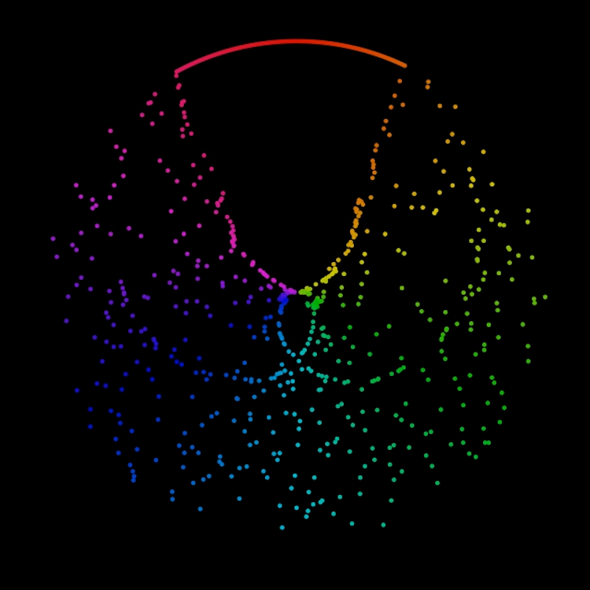

About Me
TIM HARGREAVES
Data Scientist
Work Experience
AstraZeneca
Dunnhumby, Bet365
Education
University of Warwick
Mathematics and Statistics
Data Science Outreach
Blogging at ttested.com
Python, R, and SQL Tutor
Image Source: “Yet Another Sorting
Algorithm Visualisation” – Tim Hargreaves
Notes:
Talk a bit about myself
No expectation that anyone should care so pretty picture to look at
Visualisation of a method used to sort a ‘deck of cards’

Slide 4
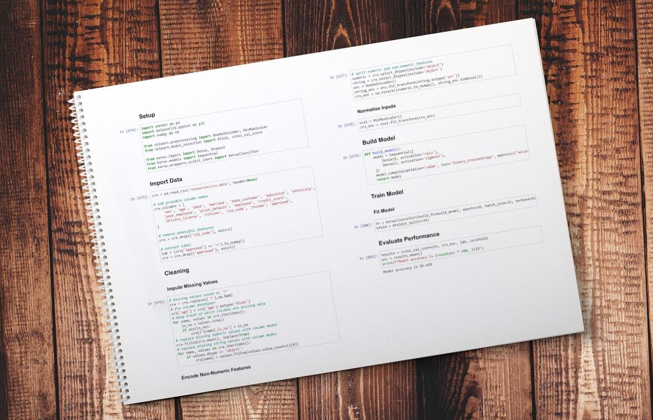
The Power of Python
How much can be achieved with just one A4 sheet of Python code?
Notes:
What it says on the tin
Before we jump the gun: what is Python, what is ML

Slide 5
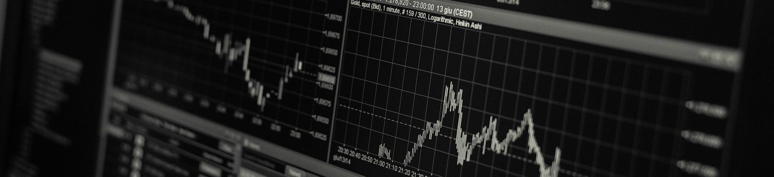
A Word of Warning
“
Snake
Oil
Data Is The New Oil
“The World's Most Valuable Resource Is No Longer Oil, but Data,” May 6, 2017. https://www.economist.com/leaders/2017/05/06/the-worlds-most-valuable-resource-is-no-longer-oil-but-data.
Notes:
Original idea for talk: stocks
Many articles claiming to predict stocks
All look good but are statistically garbage
In every case null model performs same or better
Are applications: satellite, twitter analysis
Happy to talk more after but just beware

Slide 6
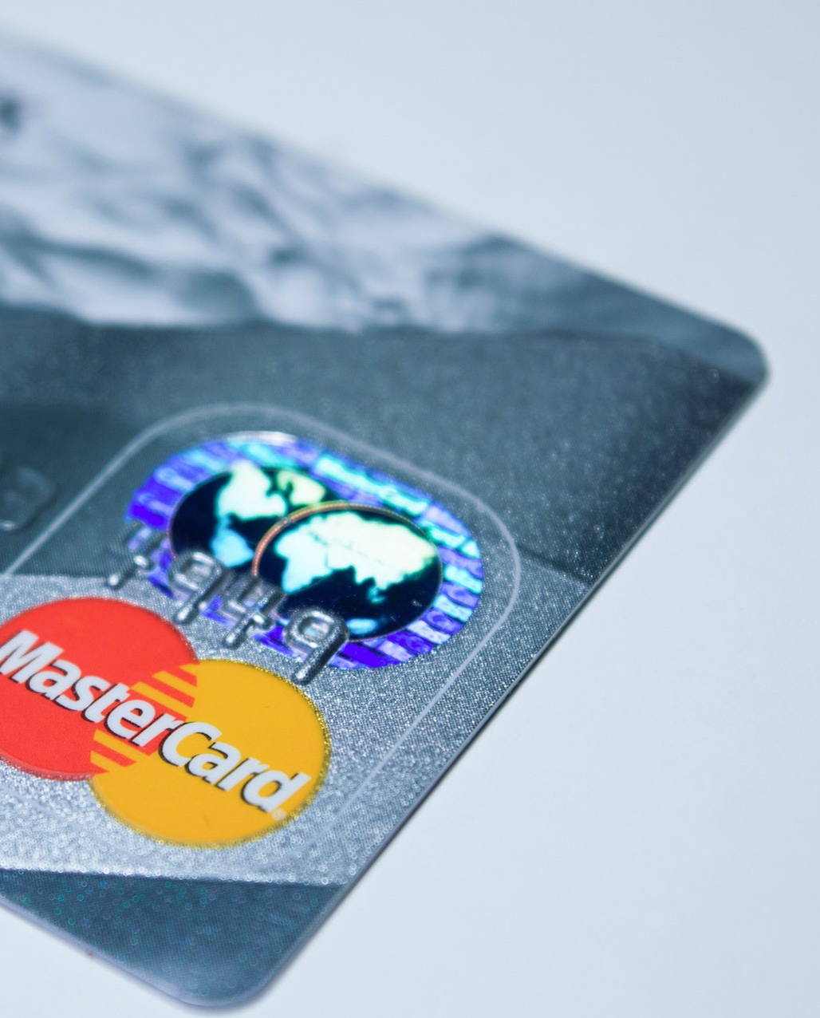
The Challenge
Can we predict whether an individual will be accepted or declined when applying for a credit card?
We will need just five steps:
Setup
Import
Clean
Build
Train
Notes:
New challenge
5 steps

Slide 7
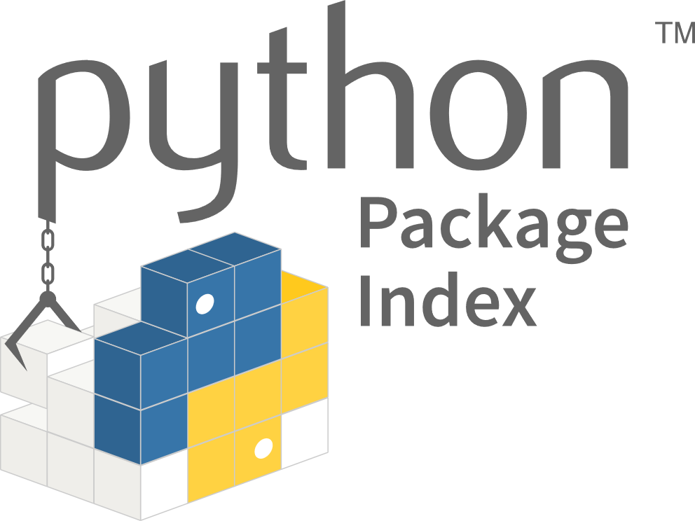
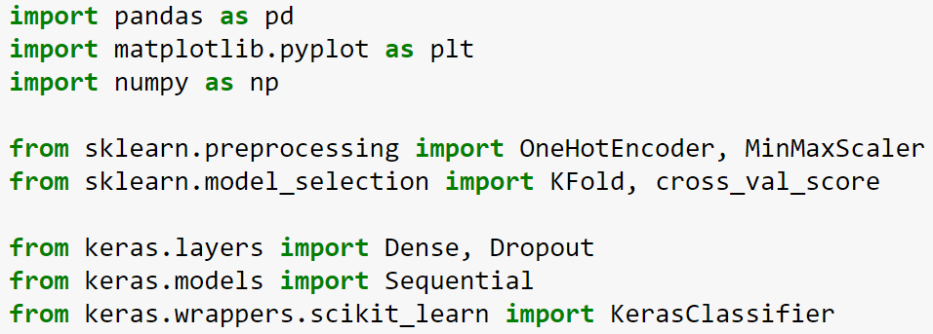
Setup
Why reinvent the wheel?
8
220,000 packages
Setup
Notes:
Package: prewritten functionality
Abstract away complex ideas
Ex: MinMaxScaler

Slide 8
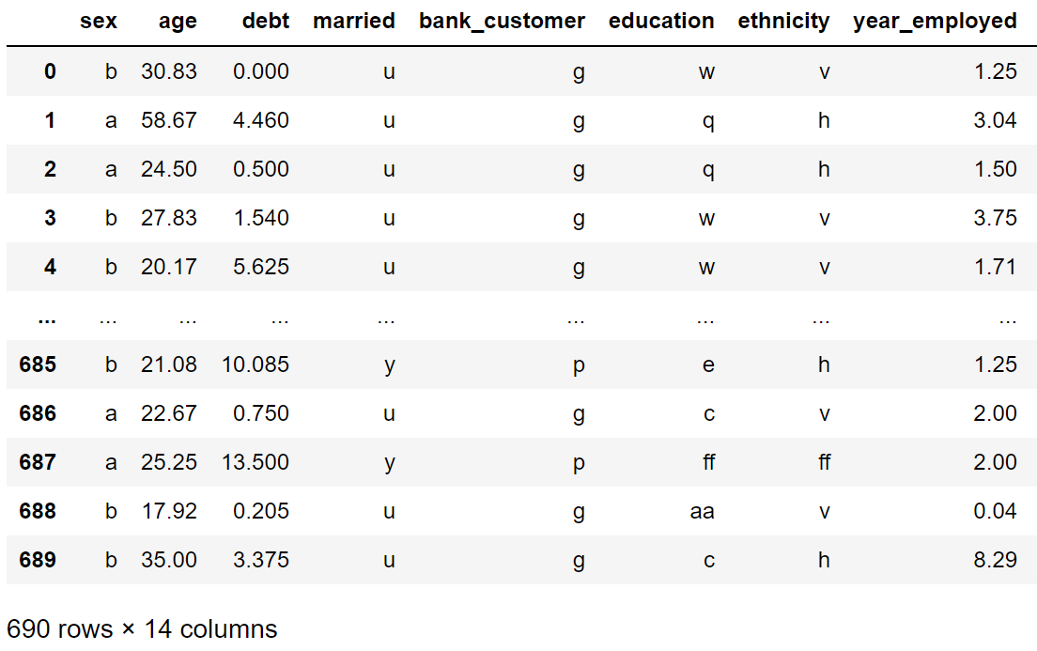
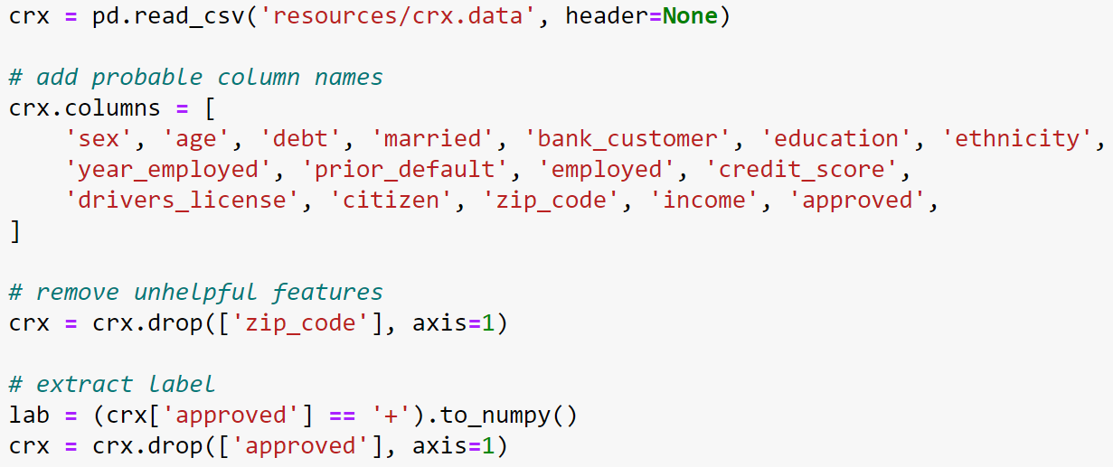
Import
Rename columns
Throw out Zip Code
9
Separate predictors and label
Setup
Import
Notes:
Notice data is anonymised
Column names are probable

Slide 9
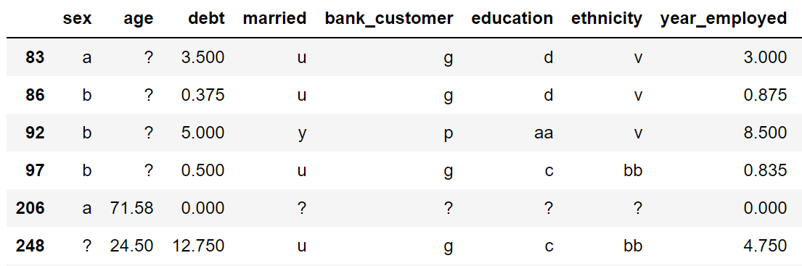
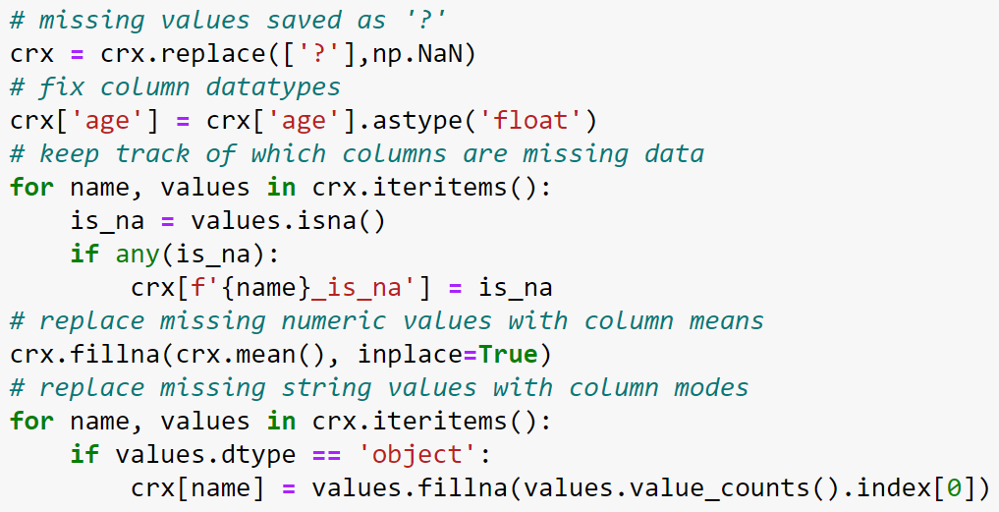
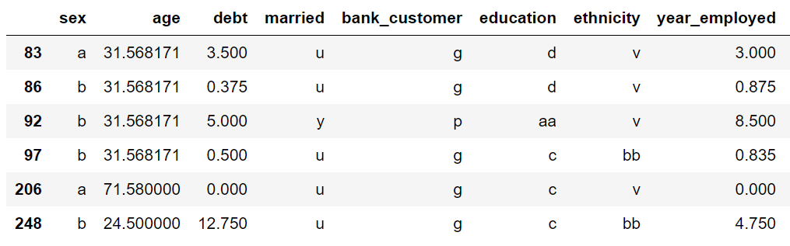
Clean
Replace missing values
with sensible guesses
keeping track of missing
10
Setup
Import
Clean

Slide 10
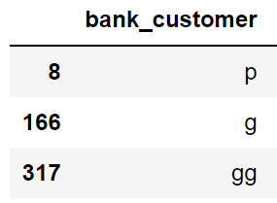
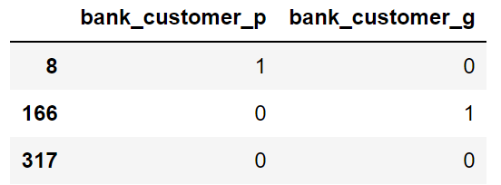
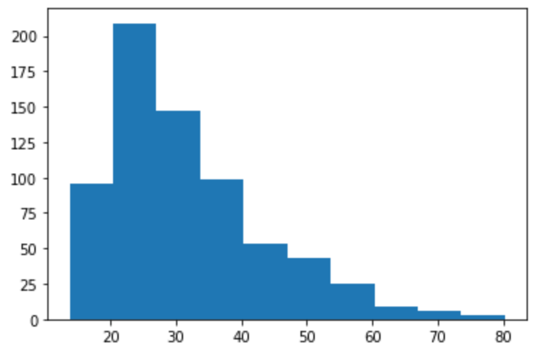
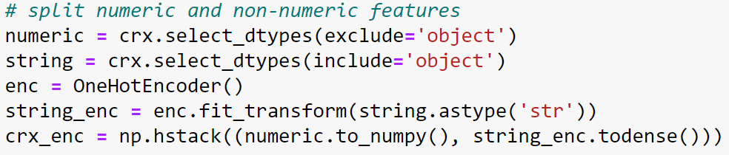
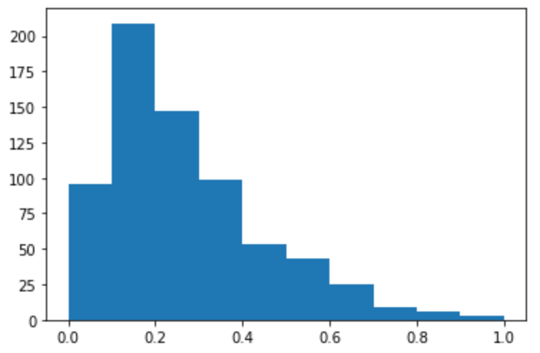
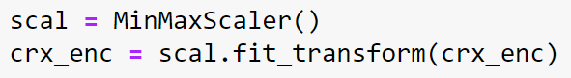
Clean (cont.)
‘Encode’ categories
‘Normalise’ predictors
5
2
Setup
Import
Clean
Clean
Notes:
Computers need data in a format they understand – numeric and scaled

Slide 11
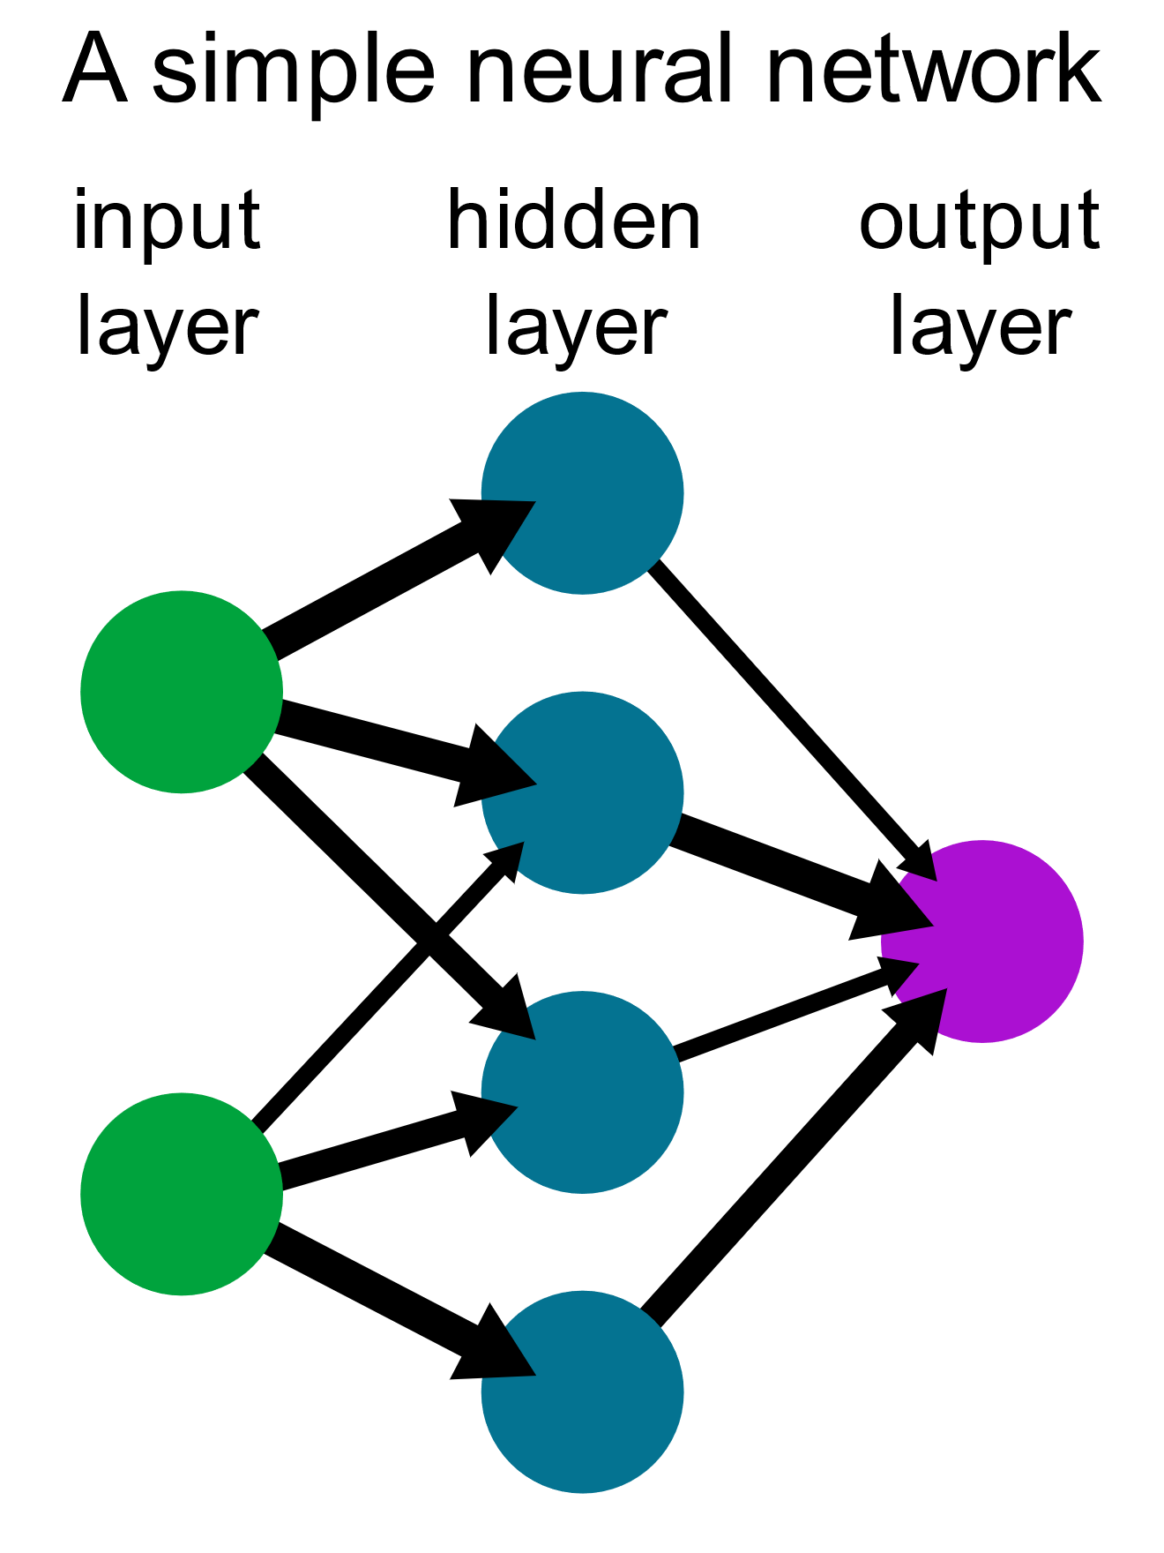
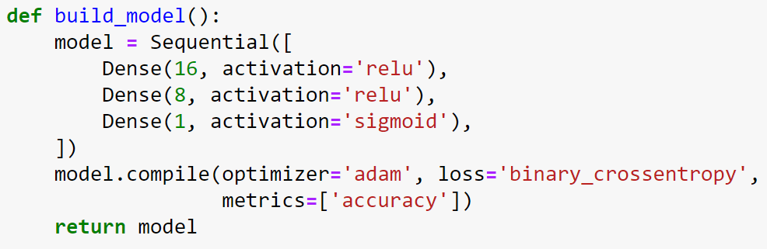
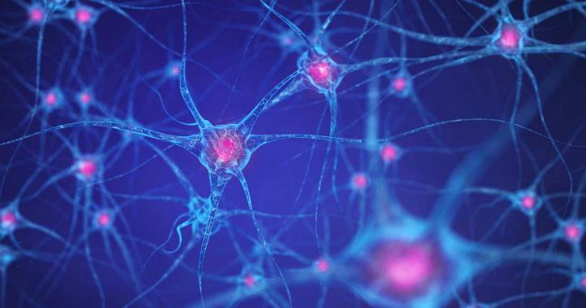
Build
Design a neural
network
9
Setup
Import
Clean
Build
Notes:
Use neural network – why? Buzzword
Simulate brain. Takes inputs, passes through neurons, reaches output
Just like we learn, so does network. Which to connect and how strong
Design is appropriate – abstraction leads to Lego-like construction

Slide 12
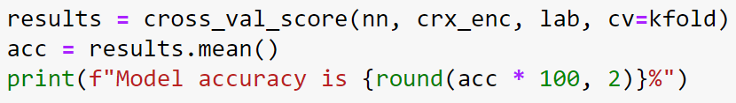
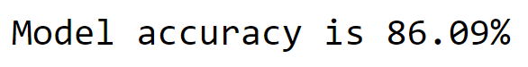
Train
Teach the network with examples
2
See how it did
3
Setup
Import
Clean
Build
Train
Train
Notes:
That’s it.
Set if off running. Few mins pass. Look at result

Slide 13
TRY IT FOR YOURSELF:
bit.ly/credit-card-applications
85%
Accuracy
<50
Lines of Code
Written in
<1 hour
Notes:
Code is available
Cloud environment so can run without needing to install or setup

Slide 14
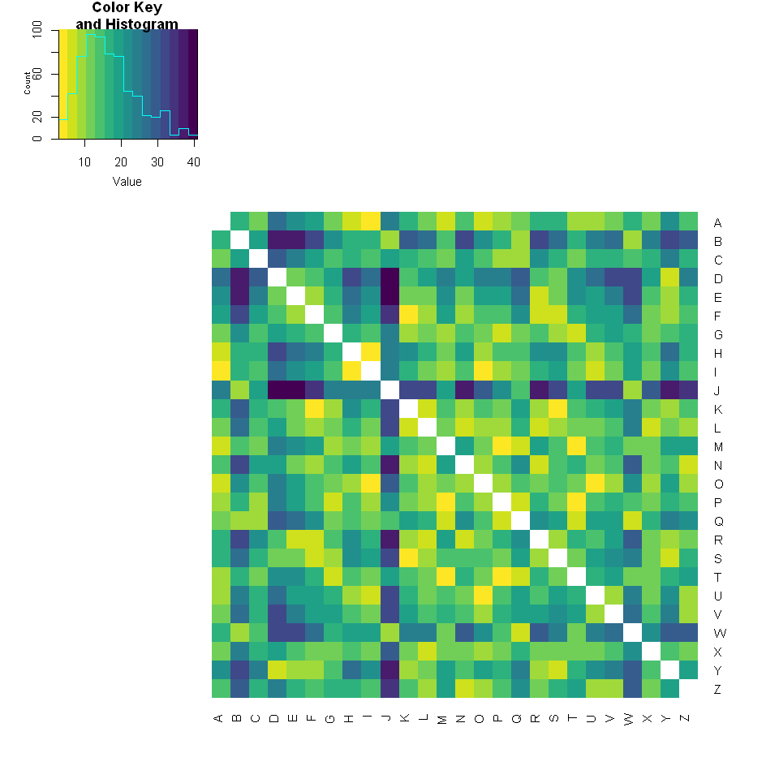
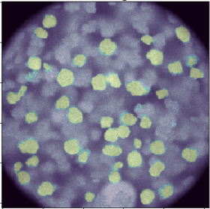
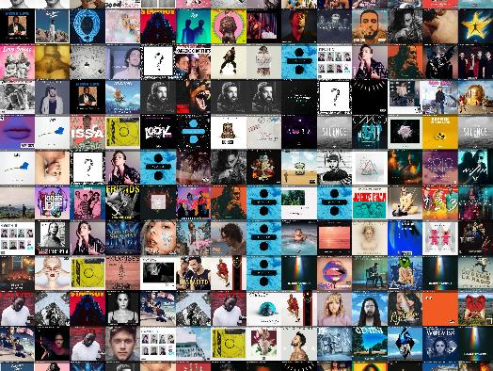
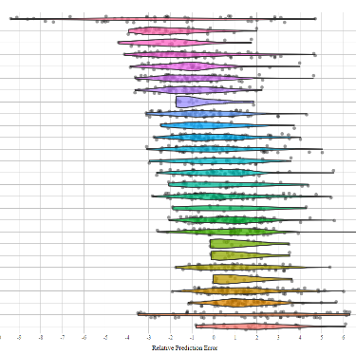
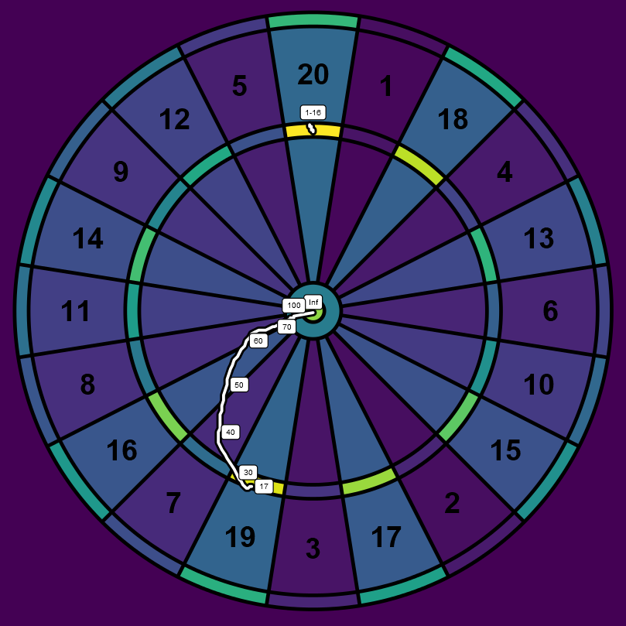
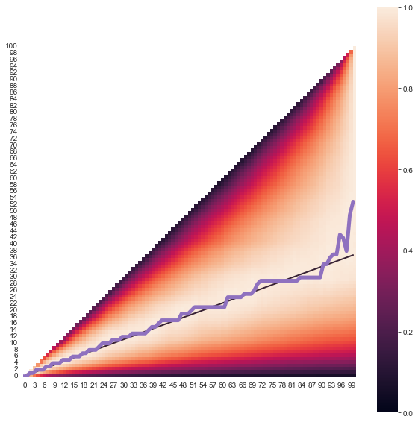
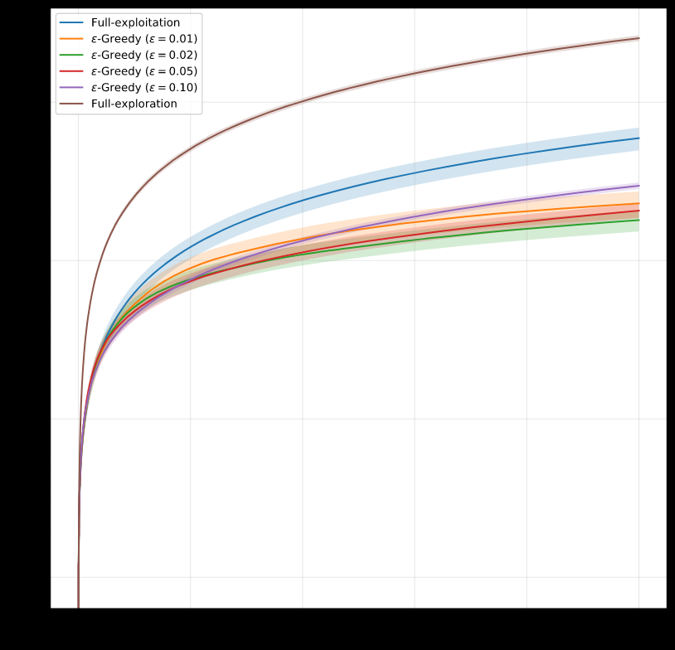
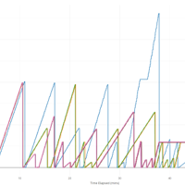

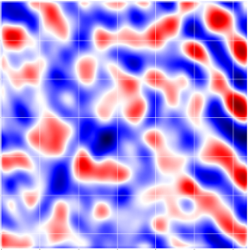
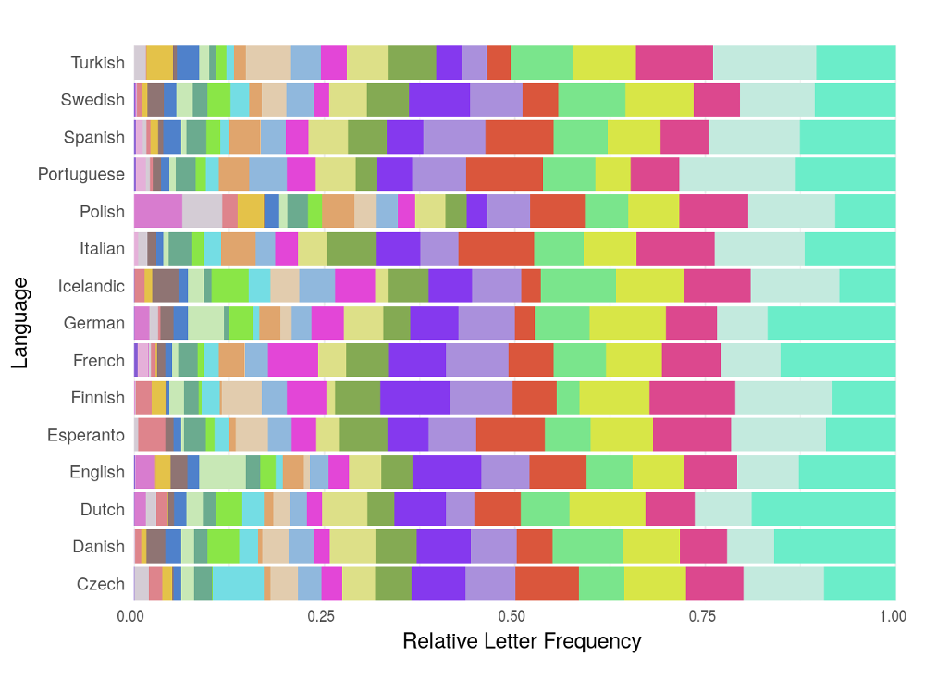
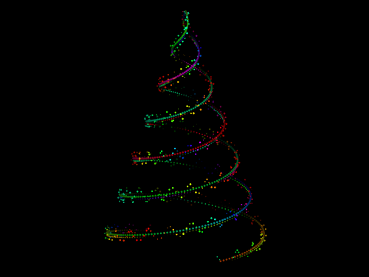
PYTHON EVERYWHERE
Notes:
Other work
Focuses: PyMetrics, Anomaly detection, Particle detection
Links to posts where appropriate

Slide 15


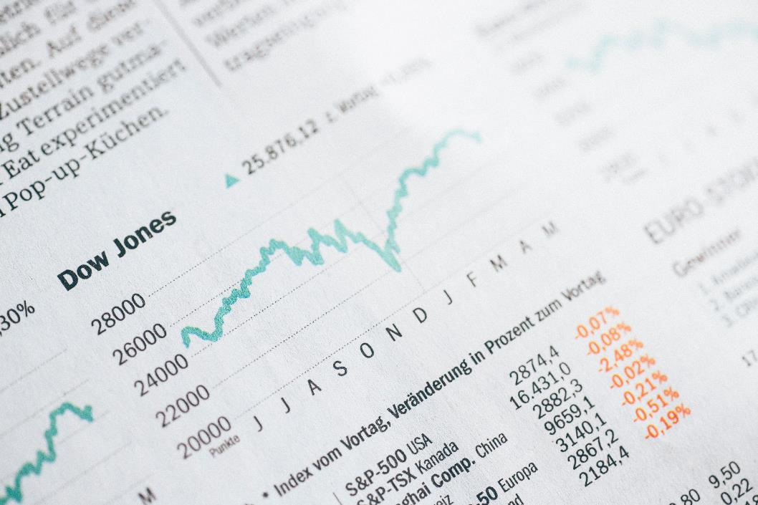





Looking Ahead
Data Democracy
The New Math
Seeing Through the Hype
Notes:
Closing notes:
Data is becoming more freely available and so more demand to exploit it
Programming is an essential skill. Schools are starting to teach it. Knowing a bit takes you far
Be realistic, be sceptical, be aware

Slide 16
THANK YOU
Tim Hargreaves
ttested.com
linkedin.com/in/tim-hargreaves

